Slide 1

Chapter 12
Multiple Access

Slide 2

Multiple Access
Data Link layer divided into two sublayers.
  The upper sublayer is responsible for datalink control,
  The lower sublayer is responsible for resolving access to the shared media.
Figure 12.1 Data link layer divided into two functionality-oriented sublayers

Slide 3

Taxonomy of multiple-access protocols
Multiple-Access Protocol
  When nodes or stations are connected and use a common link, called a multipoint or broadcast link,
  We need a multiple-access protocol to coordinate access to the link.
Figure 12.2 Taxonomy of multiple-access protocols discussed in this chapter

Slide 4
12-1 RANDOM ACCESS
In random access or contention methods, no station is superior to another station and none is assigned the control over another. No station permits, or does not permit, another station to send. At each instance, a station that has data to send uses a procedure defined by the protocol to make a decision on whether or not to send.
Topics discussed in this section:
ALOHA
Carrier Sense Multiple Access
Carrier Sense Multiple Access with Collision Detection
Carrier Sense Multiple Access with Collision Avoidance

Slide 5
Random Access
Random Access
  In a Random access method, each station has the right to the medium without being controlled by any other station.
  If more than one station tries to send, there is an access conflict – COLLISION – and the frames will be either destroyed or modified.
To avoid access conflict, each station follows a procedure.
  When can the station access the medium ?
  What can the station do if the medium is busy ?
  How can the station determine the success or failure of the transmission ?
  What can the station do if there is an access conflict ?

Slide 6
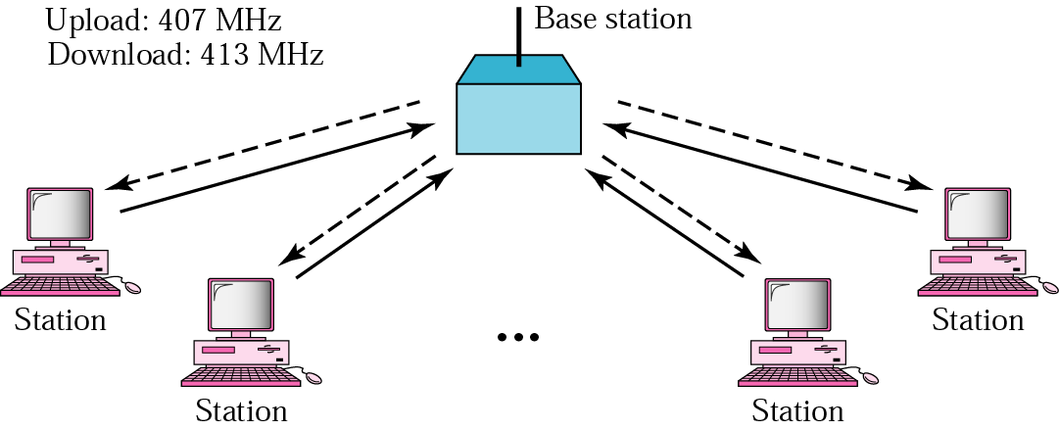
ALOHA network – Multiple Access
The earliest random-access method, was developed at the Univ. of
Hawaii in the early 1970s.
Base station is central controller
Base station acts as a hop
Potential collisions, all incoming data is @ 407 MHz

Slide 7

ALOHA
Pure ALOHA Random Access
  Each station sends a frame whenever it has a frames to send.
  However, there is only one channel to share, there is the possibility of collision between frames from different stations.
Figure 12.3 Frames in a pure ALOHA network

Slide 8

ALOHA
Figure 12.4 Procedure for pure ALOHA protocol

Slide 9
ALOHA Protocol Rule
Acknowledgement
  After sending the frame, the station waits for an acknowledgment
  If it does not receive an acknowledgement during the
  2 times the maximum propagation delay (2 x T_{p}),
  It assumes that the frame is lost; it tries sending again after
  a random amount of time (T_{B} =R x T_{P} , or R x T_{fr} ).
    T_{p} (Maximum propagation time)= distance / propagation speed
    T_{B} (Back off time) : common formula is binary exponential back-off
      R is random number choose between 0 to 2^{k} - 1
      K is the number of attempted unsuccessful transmissions
    T_{fr} (the average time required to send out a frame)

Slide 10

ALOHA
Figure 12.5 Vulnerable time for pure ALOHA protocol

Slide 11

ALOHA
Note
The throughput for pure ALOHA is
S = G × e ^{−2G} .
The maximum throughput
S_{max} = 0.184 when G= (1/2).
S is the average number of successful transmissions,
called throughput.
G is the average number of frames generated by the system
during one frame transmission time.

Slide 12

Slotted ALOHA
Slotted ALOHA
  We divide the time into slots of T_{fr} s and force the station to send only at the beginning of the time slot.
Figure 12.6 Frames in a slotted ALOHA network

Slide 13
Slotted ALOHA
Note
The throughput for slotted ALOHA is
S = G × e^{−G} .
The maximum throughput
S_{max} = 0.368 when G = 1.

Slide 14

Slotted ALOHA
  Slotted ALOHA vulnerable time = T_{fr}
Figure 12.7 Vulnerable time for slotted ALOHA protocol

Slide 15
Carrier Sense Multiple Access (CSMA)
To minimize the chance of collision and, therefore, increase the performance, the CSMA method was developed.
CSMA is based on the principle “sense before transmit” or “listen before talk.”
CSMA can reduce the possibility of collision, but it cannot eliminate it.
  The possibility of collision still exists because of propagation delay; a station may sense the medium and find it idle, only because the first bit sent by another station has not yet been received.

Slide 16

Carrier Sense Multiple Access (CSMA)
Figure 12.8 Space/time model of the collision in CSMA

Slide 17

Carrier Sense Multiple Access (CSMA)
(T_{P})
Figure 12.9 Vulnerable time in CSMA

Slide 18
Persistence methods
Persistence strategy defines the procedures for a station that senses a busy medium.
Three strategies have been developed;
  1-persistent method : after the station finds the line idle, it sends its frame immediately (with probability 1)
  non-persistent method :
    a station that has a frame to send senses the line.
    If the line is idle, it sends immediately.
    If the line is not idle, it waits a random amount of time and then senses the line again.
  p-persistent method : After the station finds the line idle,
    With probability P, the station sends its frames
    With probability q=1-p, the station waits for the beginning of the next time slot and checks the line again.

Slide 19

Carrier Sense Multiple Access (CSMA)
Figure 12.10 Behavior of three persistence methods

Slide 20

Carrier Sense Multiple Access (CSMA)
Figure 12.11 Flow diagram for three persistence methods

Slide 21

CSMA with Collision Detection (CSMA/CD)
CSMA/CD adds a procedure to handle the collision.
  A station monitors the medium after it sends a frame to see if the transmission was successful.
    If so, the station is finished.
    If there is a collision, the frame is sent again.
Figure 12.12 Collision of the first bit in CSMA/CD

Slide 22

CSMA with Collision Detection (CSMA/CD)
Minimum Frame Size
  For CSMA/CD to work, we need a restriction on the frame size.
  The frame transmission time T_{fr} must be at least two times the maximum propagation time T_{p} .
Figure 12.13 Collision and abortion in CSMA/CD

Slide 23

CSMA with Collision Detection (CSMA/CD)
Figure 12.14 Flow diagram for the CSMA/CD

Slide 24

CSMA with Collision Detection (CSMA/CD)
Figure 12.15 Energy level during transmission, idleness, or collision

Slide 25

CSMA with Collision Avoidance (CSMA/CA)
CSMA/CA was invented for the wireless networks to avoid collisions.
  Collisions are avoided through the use of CSMA/CA’s three strategies:
    The interframe space, the contention window, and acknowledgments.
Figure 12.16 Timing in CSMA/CA

Slide 26
CSMA with Collision Detection (CSMA/CD)
Note
In CSMA/CA, the IFS can also be used to define the priority of a station or a frame.

Slide 27
CSMA with Collision Detection (CSMA/CD)
Note
In CSMA/CA, if the station finds the channel busy, it does not restart the timer of the contention window;
it stops the timer and restarts it when the channel becomes idle.

Slide 28

CSMA with Collision Detection (CSMA/CD)
Figure 12.17 Flow diagram for CSMA/CA

Slide 29
12-2 CONTROLLED ACCESS
In controlled access, the stations consult one another to find which station has the right to send. A station cannot send unless it has been authorized by other stations. We discuss three popular controlled-access methods.
Topics discussed in this section:
Reservation
Polling
Token Passing

Slide 30

Reservation
A station need to make a reservation before sending data
  In each interval, a reservation frame precedes the data frames sent in that interval.
  If there are N stations in the system, there are exactly N reservation minislots in the reservation frame. Each minislot belongs to a station.
  When a station needs to send a data frame, it makes a reservation in its own minislot.
  The stations that have made reservations can send their data frames after the reservation frame.
Figure 12.18 Reservation access method

Slide 31
Polling
Polling works with topologies in which one device is designed as a Primary Station and the other devices are Secondary Station.
  The primary device controls the link;
  The secondary devices follow its instruction.
Poll function : If the primary want to receive data, it asks the secondaries if they have anything to send.
Select function : If the primary wants to send data, it tells the secondary to get ready to receive.

Slide 32

Polling
Figure 12.19 Select and poll functions in polling access method

Slide 33
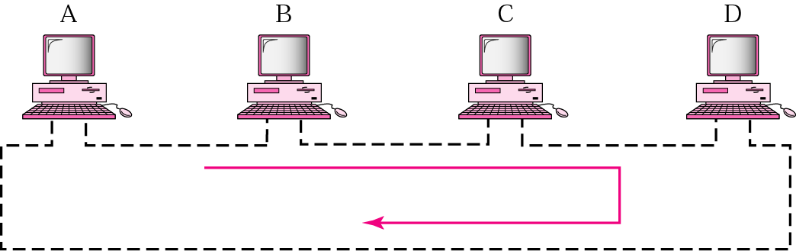
Token-passing network
A station is authorized to send data when it receives a special frame called a token

Slide 34

Token-passing network
Figure 12.20 Logical ring and physical topology in token-passing access method

Slide 35
12-3 CHANNELIZATION
Channelization is a multiple-access method in which the available bandwidth of a link is shared in time, frequency, or through code, between different stations. In this section, we discuss three channelization protocols.
Topics discussed in this section:
Frequency-Division Multiple Access (FDMA)
Time-Division Multiple Access (TDMA)
Code-Division Multiple Access (CDMA)

Slide 36
FDMA
The available bandwidth is shared by all stations.
The FDMA is a data link layer protocol that uses FDM at the physical layer
In FDMA, the available bandwidth
of the common channel is divided into bands that are separated by guard bands.

Slide 37

FDMA
Figure 12.21 Frequency-division multiple access (FDMA)

Slide 38
TDMA
The entire bandwidth is just one channel.
Stations share the capacity of the channel in time
In TDMA, the bandwidth is just one channel that is timeshared between different stations.

Slide 39

FDMA
Figure 12.22 Time-division multiple access (TDMA)

Slide 40
CDMA
CDMA differs from FDMA because only one channel occupies the entire bandwidth of the link.
It differs from TDMA because all stations can send data simultaneously; there is no time sharing.
In CDMA, one channel carries all transmissions simultaneously.

Slide 41

CDMA
  The assigned codes have two properties.
  If we multiply each code by another, we get 0,
2. If we multiply each code by itself, we get 4
(the number of stations)
ex) Data = (d₁ c₁ + d₂ c₂ + d₃ c₃ + d₄ c₄ ) x c₁ = 4 x d₁
Figure 12.23 Simple idea of communication with code

Slide 42
CDMA
CDMA is based on coding theory
Each station is assigned a code, which is a sequence of numbers called chips.
Figure 12.24 Chip sequences

Slide 43
Properties of Orthogonal Sequences
Orthogonal sequences
  (1) Inner-product of two equal sequences
  ○ A•A = N
  ○ If we multiply two different sequences, element by element, and add the results, we get 0.
  A•B = 0
  (2) A•(-A) = -N

Slide 44
CDMA – Data Representation
When a station is idle, it sends no signal, which is represented by a 0.
Figure 12.25 Data representation in CDMA

Slide 45

Encoding and Decoding
Figure 12.26 Sharing channel in CDMA

Slide 46

Encoding and Decoding
Figure 12.27 Digital signal created by four stations in CDMA

Slide 47
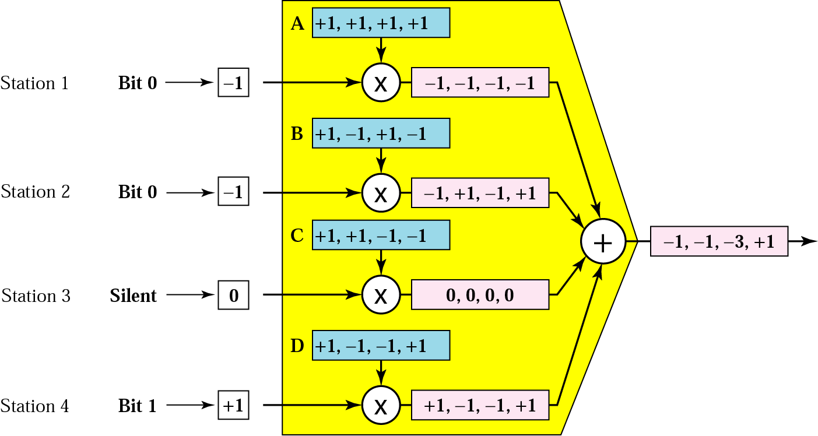
CDMA - Encoding Rules
Showing how four stations share the link during 1-bit interval.
CDMA Multiplexer

Slide 48

CDMA - Encoding Rules
Figure 12.28 Decoding of the composite signal for one in CDMA

Slide 49
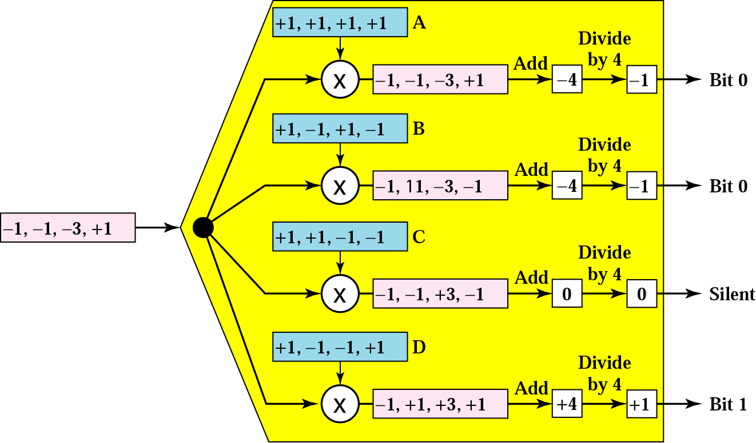
CDMA - Encoding Rules
CDMA Demultiplexer
++
+
+

Slide 50

CDMA - Sequence Generation
To generate sequences, we use a Walsh table, a two-dimensional table with an equal number of rows and columns.
Each row is a sequence of chips
Figure 12.29 General rule and examples of creating Walsh tables

Slide 51
CDMA - Encoding Rules
Note
The number of sequences in a Walsh table needs to be N = 2^{m}.

Slide 52
CDMA - Encoding Rules
Example 12.6
Find the chips for a network with
a. Two stations b. Four stations
Solution
We can use the rows of W₂ and W₄ in Figure 12.29:
a. For a two-station network, we have
[+1 +1] and [+1 −1].
b. For a four-station network we have
[+1 +1 +1 +1], [+1 −1 +1 −1],
[+1 +1 −1 −1], and [+1 −1 −1 +1].

Slide 53
CDMA - Encoding Rules
Example 12.7
What is the number of sequences if we have 90 stations in our network?
Solution
The number of sequences needs to be 2^{m}. We need to choose m = 7 and N = 2⁷ or 128. We can then use 90
of the sequences as the chips.

Slide 54

Q and A

